Slide 1
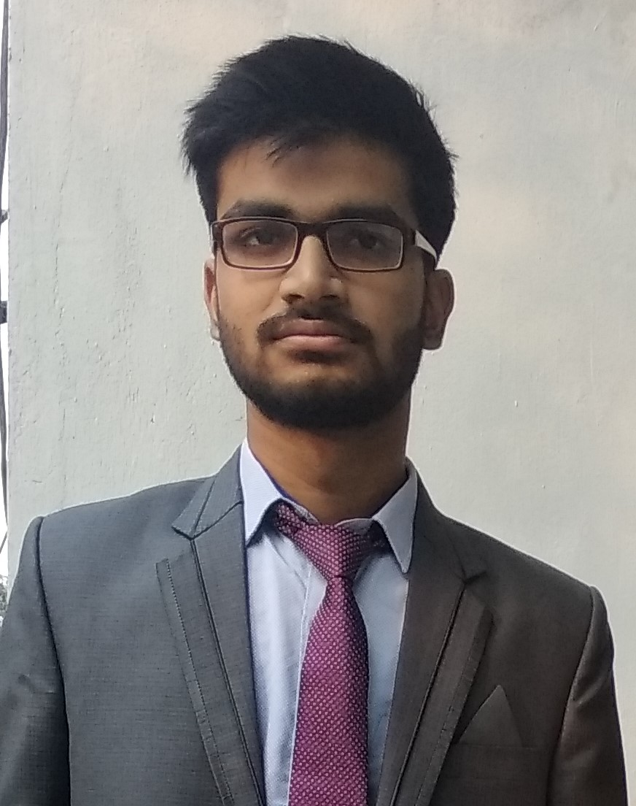
Student Details
Name: Kaustubh Gupta
SkillBuild Email ID:kaustubhg10@gmail.com
College name:Krishna Institue of Engineering and Technology,Ghaziabad,UP
College state:Uttar Pradesh
Intership domain: Data analytics/12-06-2023 to 24-07-2023

Slide 2
PROJECT TITLE/Problem Statement
Title:”Data analysis over the superstore dataset”
In this we have to perform data analysis on superstore dataset using different python libraries and create some insightful visualizations and draw some inferences.

Slide 3
AGENDA
To perform ETL and EDA over given dataset using libraries like numpy ,pandas,matplotlib,seaborn,etc.

Slide 4
PROJECT OVERVIEW
In this ,I have analysed the superstore dataset over kaggle and using pandas created dataframe,
perform some univariate and bivariate analysis,using matplotlib and seaborn created some visualizations,used panda profiler library to cread a insightfull report.

Slide 5
WHO ARE THE END USERS of this project?
The end user are ,the stakeholder to understand the business insights & the ML engineers who will use this insights for creating ML models.

Slide 6
YOUR SOLUTION AND ITS VALUE PROPOSITION
This project helps to understand insights from the given dataset,the relationship between different features,distribution of data,bivariate and univariate analysis,understanding customers and the profit &sales regions and their visualisations .

Slide 7
How did you customize the project and make it your own
My customization:
I have perform univariate analysis over different features of dataset.
Use seaborn library to estimate the pdf plot of sales and profit.
Used pandas profiler to generate a insightfull report about our data.

Slide 8
MODELLING
I have used pandas for creating dataframe from csv file.
Used different pandas inbuilt functions like, describe,info,drop etc.
Performed univariate analysis over different features of datase
Used matplotlib for plotting bar chats,pie charts.
Use seaborn library to estimate the pdf plot of sales and profit.
Used pandas profiler to generate a insightfull report about our data.

Slide 9
Results
I have generated some visualizations about region wise sales,region wise profits ,segment wise profits, etc & created a report regarding our dataset .The link is given in next slide.........

Slide 10
links
Github link:https://github.com/ka-us-tubh/ibmskill_superstore_dataanalysis.git

